Slide 1


Advancing Breast Models Through Improved Tumor Complexity for AI-Based Cancer Detection
23-10-2025
Tim Diepstraten
MSc Externship Project at the Early Warning Scan

Slide 2
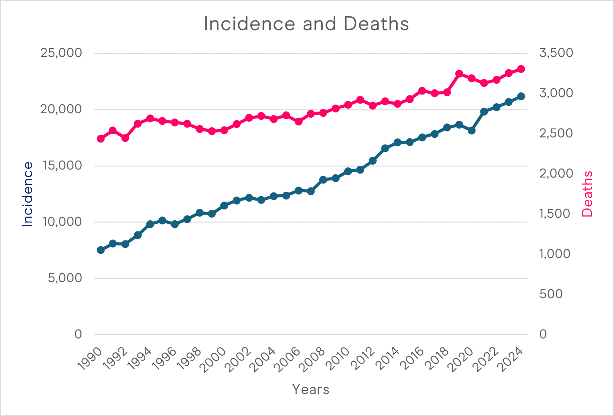
Introduction
2.3 million annual cases of breast cancer
Leading cause of cancer-related death among women
Lack of early symptoms
→ Late disease detection
Solution:
Better early screening methods
Breast Cancer in Australia
National Breast Cancer Foundation (Australia)

Slide 3
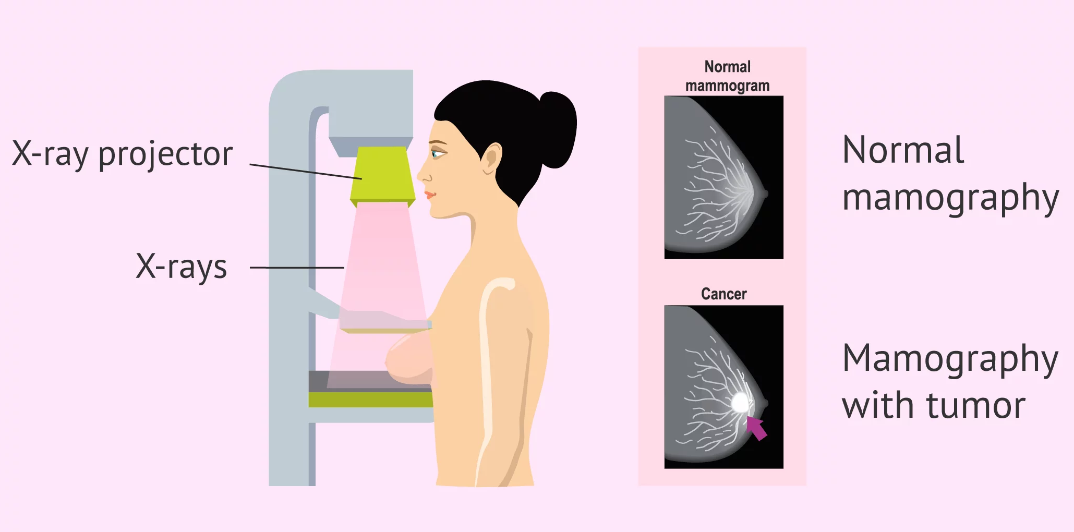
Mammography
Standard for breast cancer screening
inviTRA
Notes:
One fifth of breast cancer patients in the Netherlands are under 40 (~3000 women annually)

Slide 4
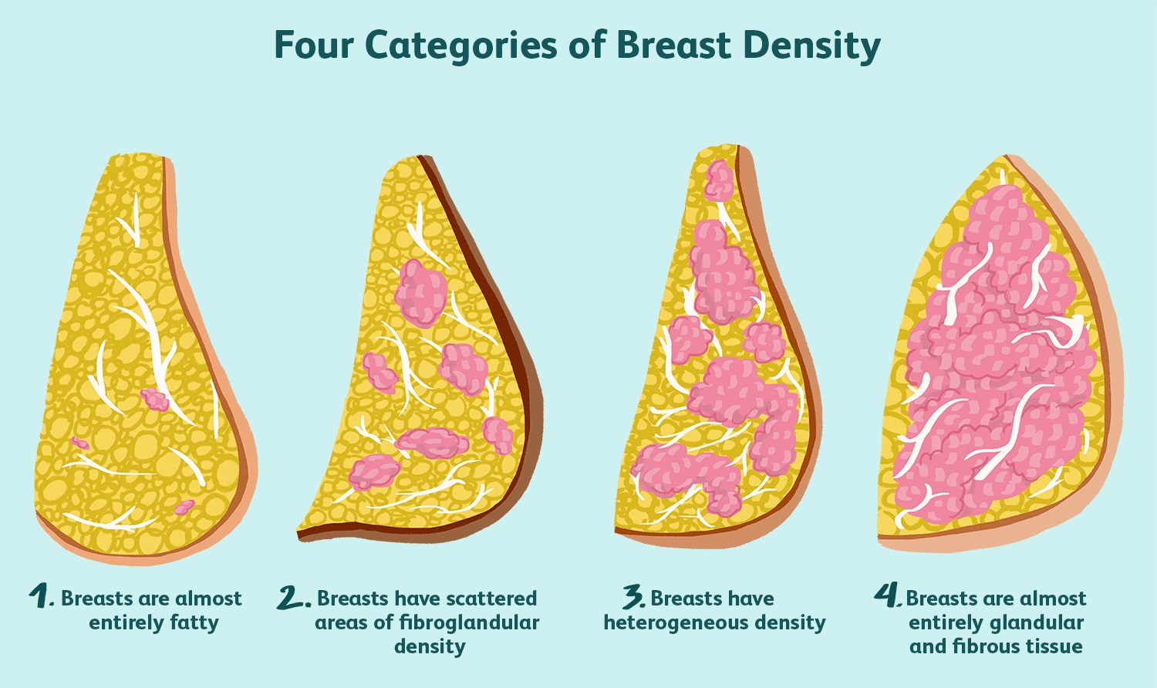
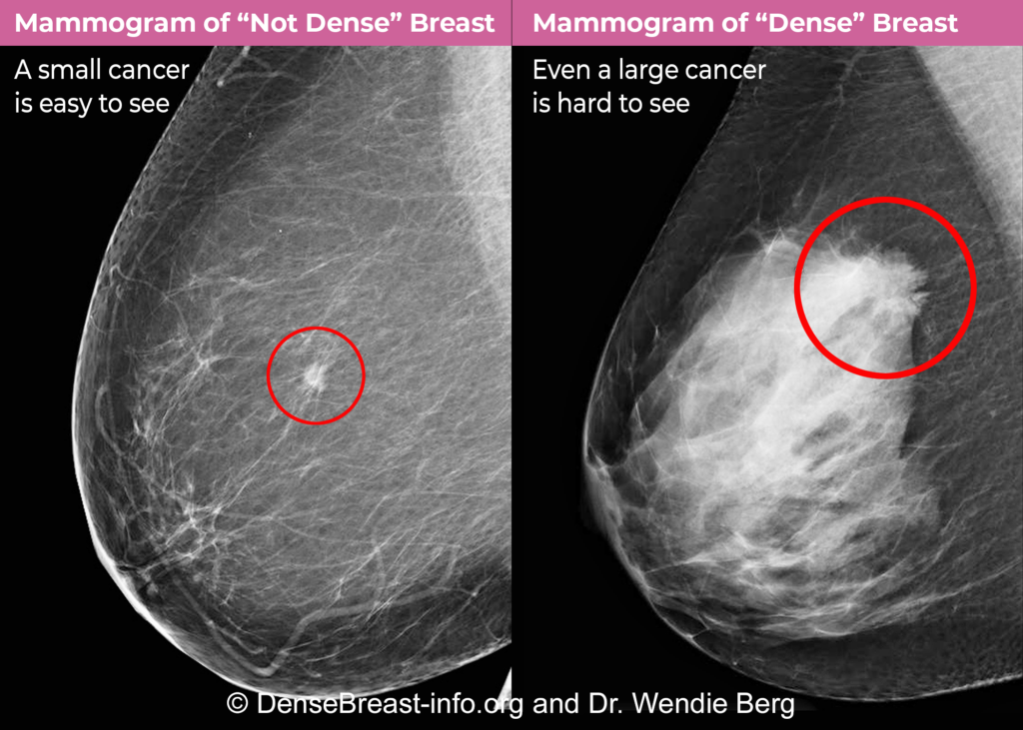
Shortcomings of Mammography
Radiation Exposure
Discomfort
Cost
Dense vs fatty tissue
High false positives/negatives
No screening for women under 50
We need to do better!
VeryWell Health
Notes:
In the Netherlands, 30% of women do not partake in screening.

Slide 5

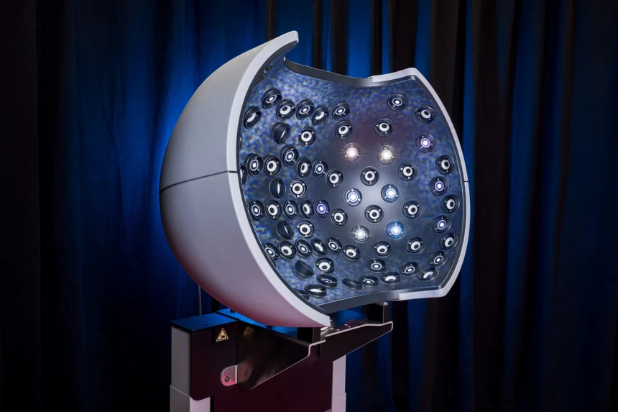
The Early Warning Scan
Dutch startup company
New approach to breast cancer screening
Image acquisition
52 cameras

Slide 6
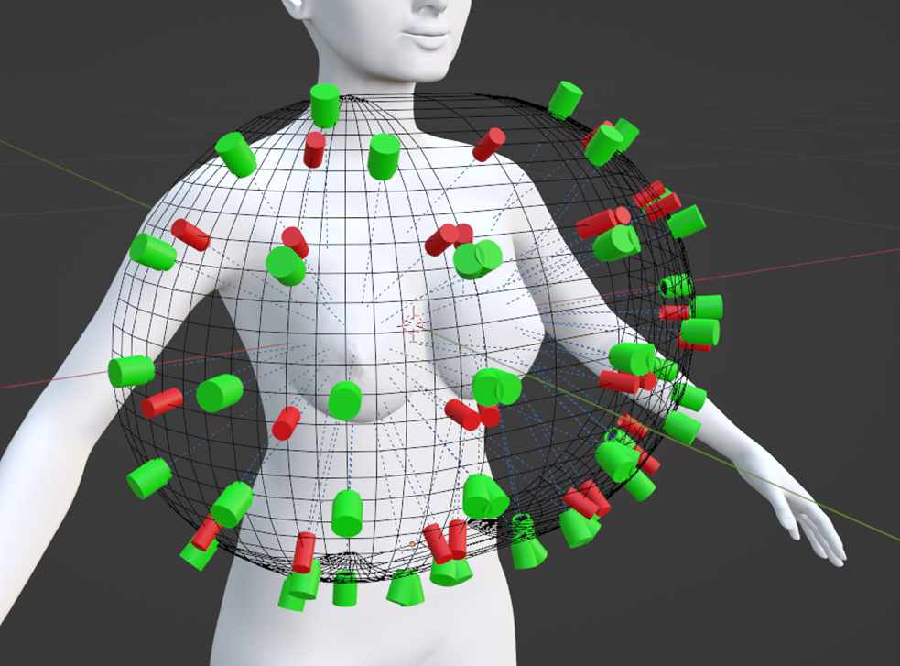
The Early Warning Scan
Dutch startup company
New approach to breast cancer screening
Image acquisition
52 cameras

Slide 7
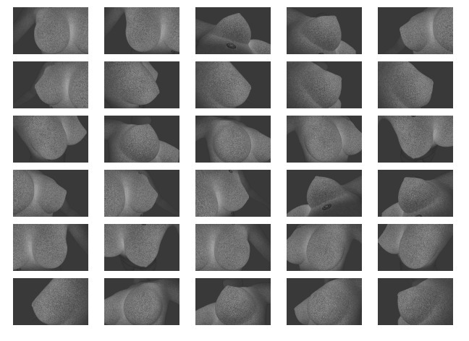
The Early Warning Scan
Dutch startup company
New approach to breast cancer screening
Image acquisition
52 cameras
Photogrammetry

Slide 8
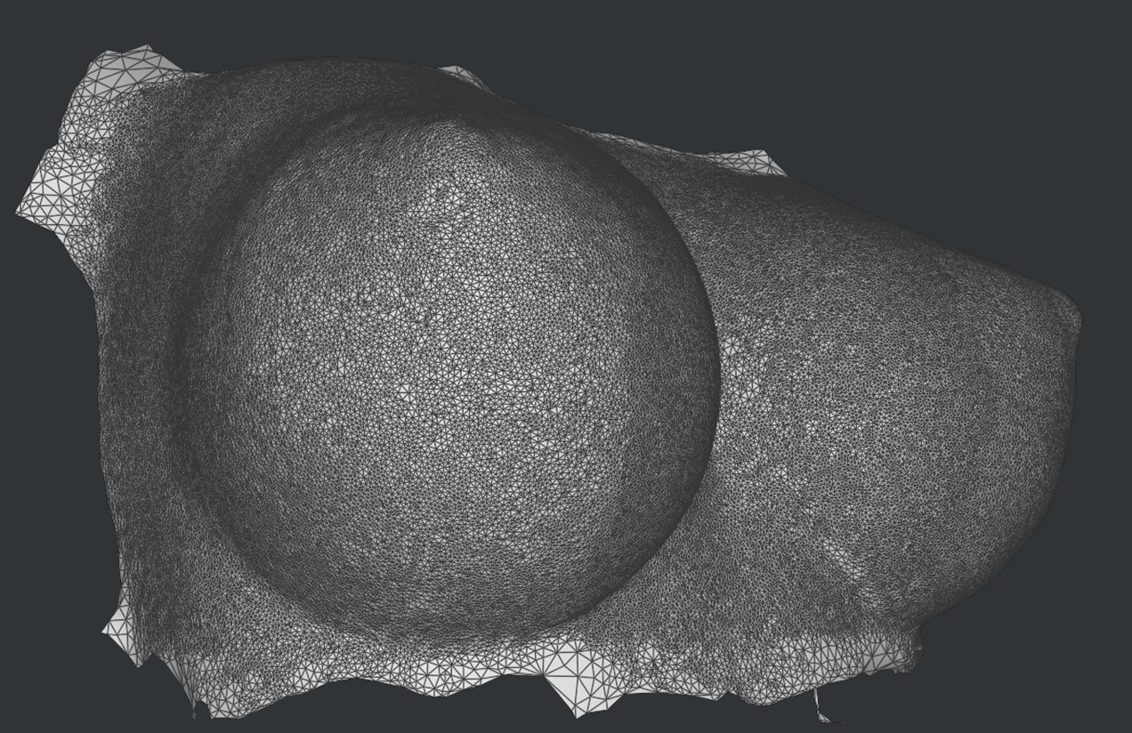
The Early Warning Scan
Dutch startup company
New approach to breast cancer screening
Image acquisition
Dynamic 3d Model
Breast movement is tracked at 340 locations

Slide 9
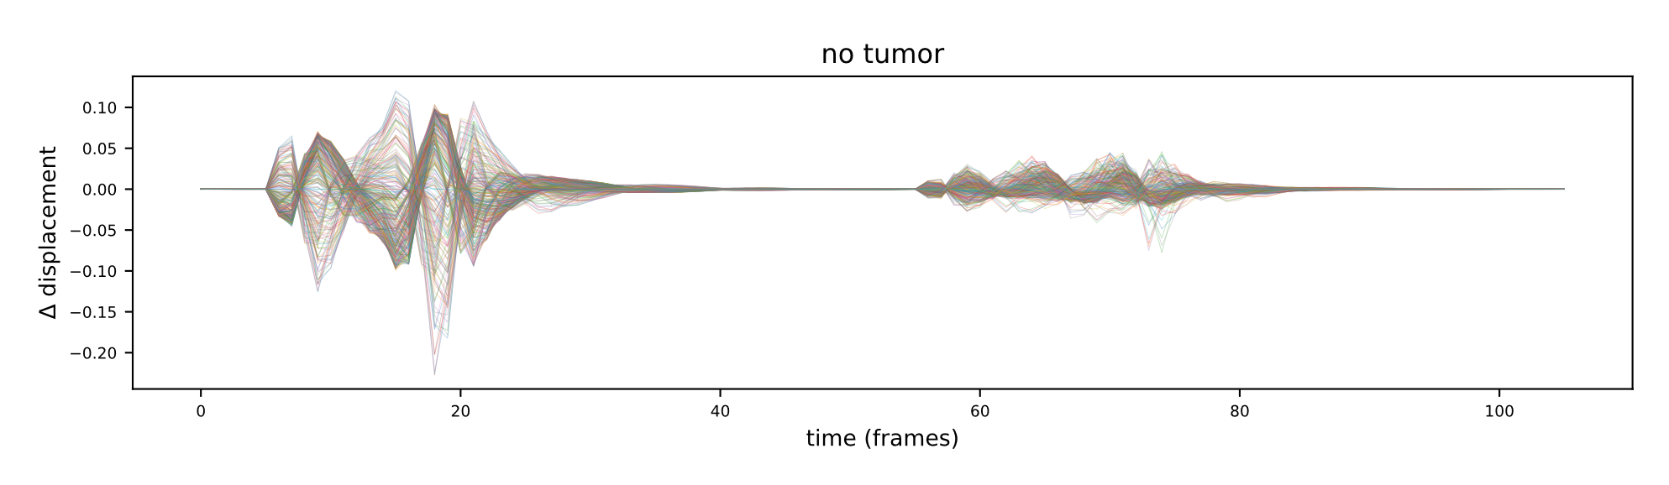
The Early Warning Scan
Dutch startup company
New approach to breast cancer screening
Image acquisition
Dynamic 3d Model
Data extraction
Frequency decomposition

Slide 10
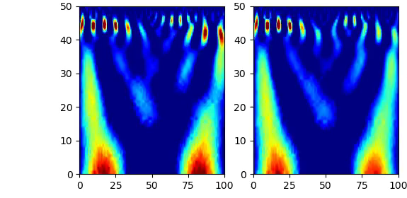
The Early Warning Scan
Dutch startup company
New approach to breast cancer screening
Image acquisition
Dynamic 3d Model
Data extraction
Frequency decomposition

Slide 11
The Early Warning Scan
Dutch startup company
New approach to breast cancer screening
Image acquisition
Dynamic 3d Model
Data extraction
AI-powered risk assessment

Slide 12
The Early Warning Scan
Advantages over mammography:
Painless
No X-rays
Low-cost
Effective on dense tissue

Slide 13
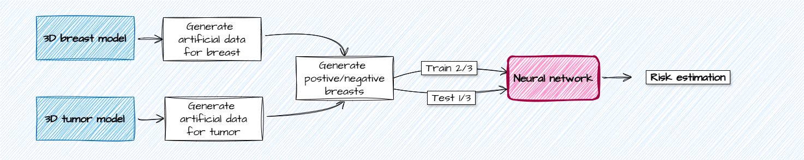
Current Challenges
Acquisition of training data for AI
Develop software to produce breast models
FEM modeling
Incremental process
My project:
Improve model generation by incorporating tumors with variable characteristics

Slide 14
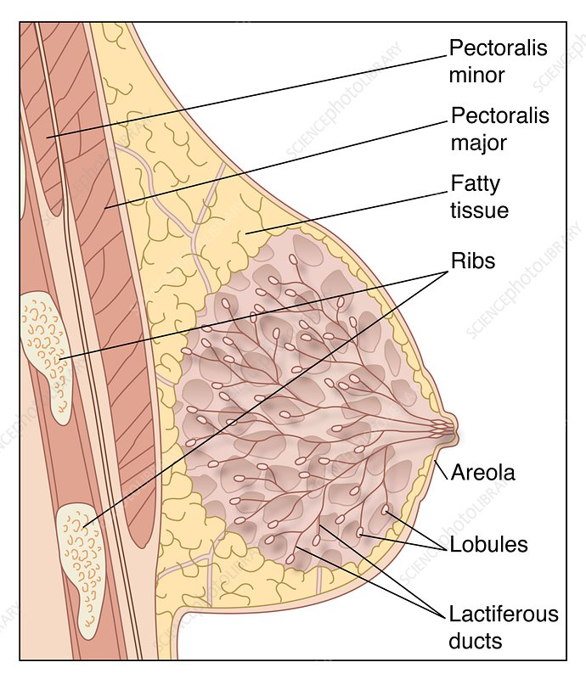
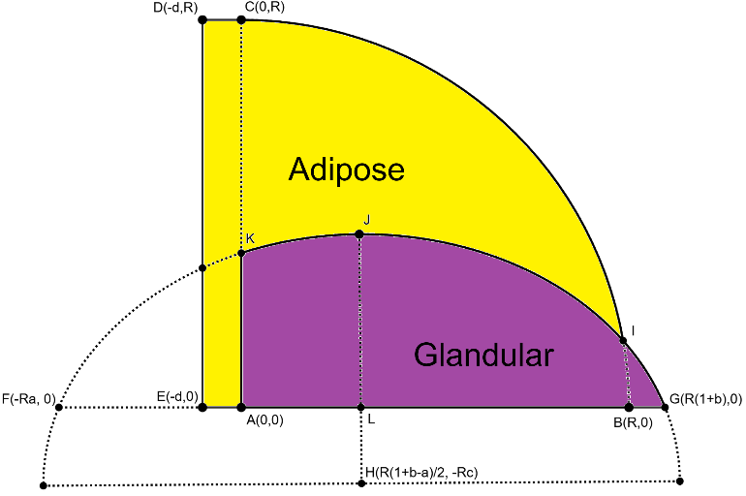
Introducing The Breast Model
Defining breast area
Rotation around y-axis

Slide 15
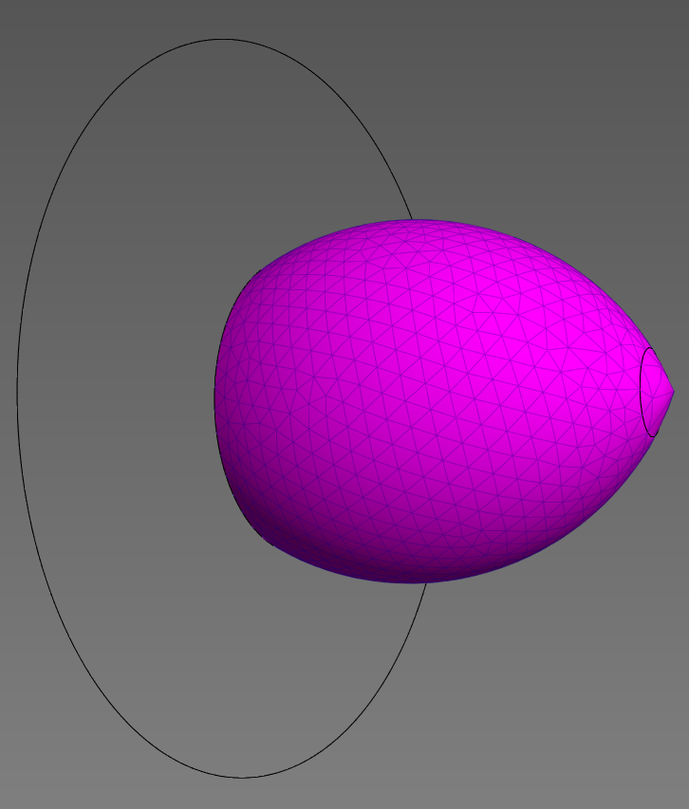
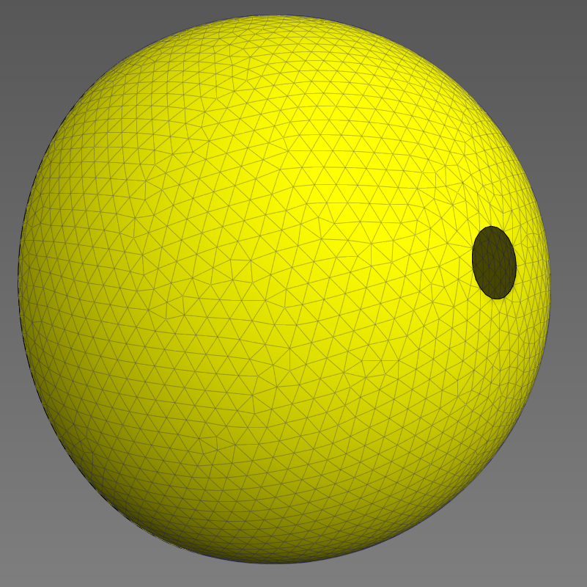
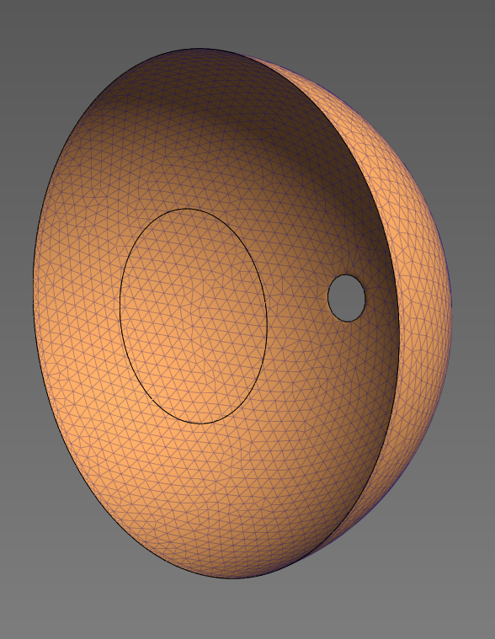
Introducing The Breast Model
Mesh generation → Gmsh software
Simulation → FEBio software
Individual material properties
≈16k nodes
≈14k elements
Glandular (30%)
Adipose (70%)
Skin

Slide 16
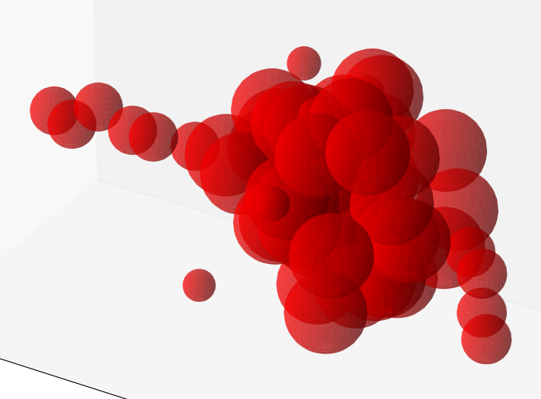
Procedural Tumor Generation
Parameters determine growth behavior of spheres
No separate mesh
Modification of material properties
5x stiffer compared to non-tumorous

Slide 17
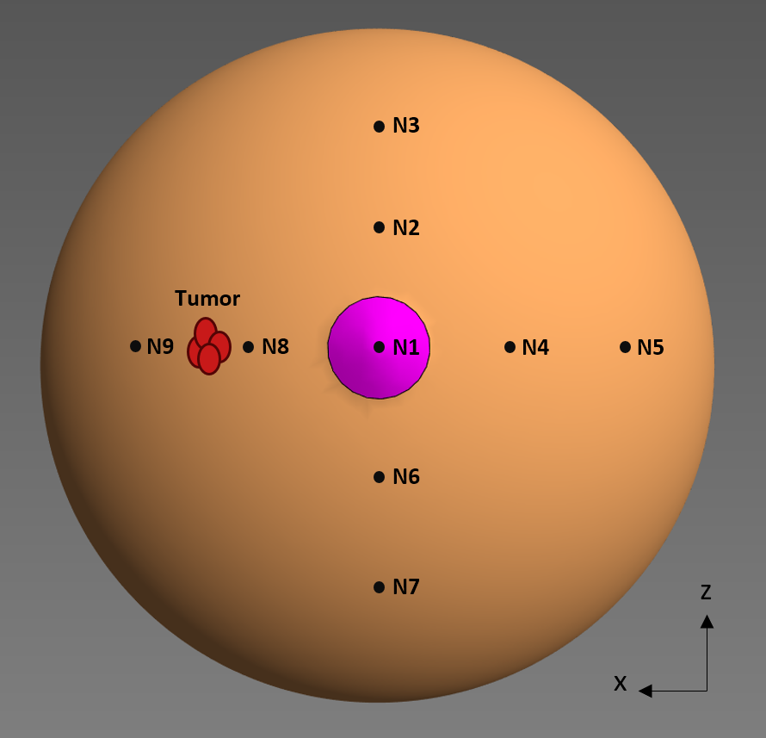
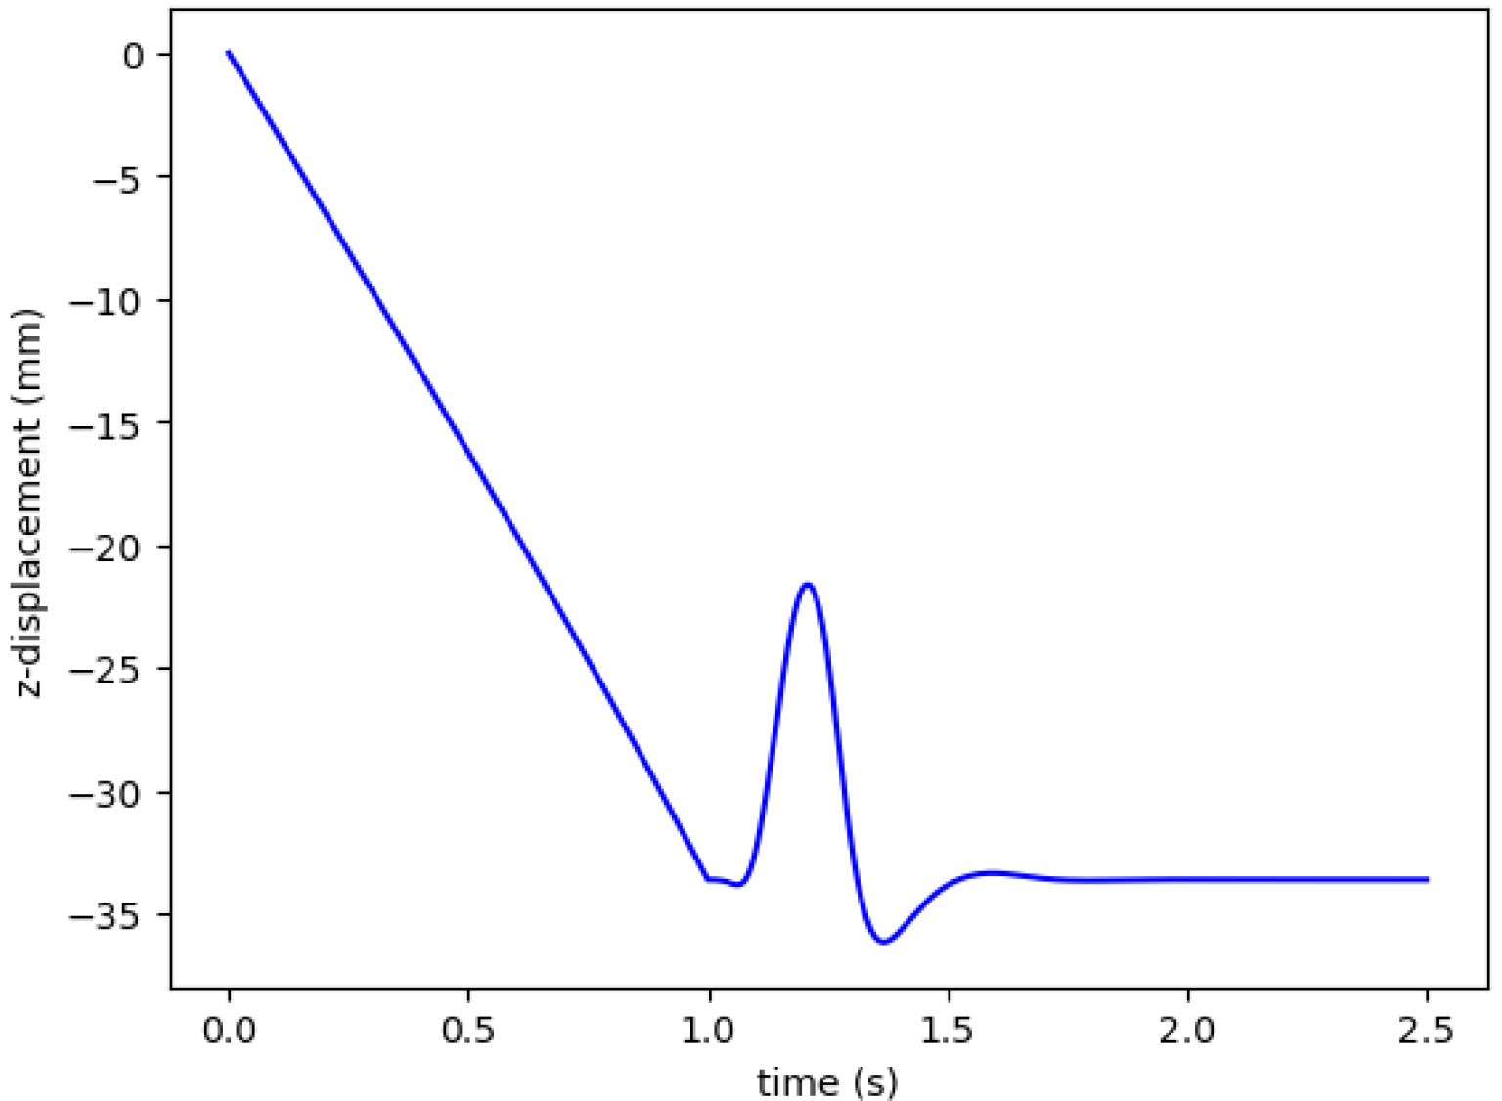
Testing Methodology
Breast diameter: 14cm
Tumor placed at (35mm, 40mm, 0mm)
Gravity and initial displacement

Slide 18

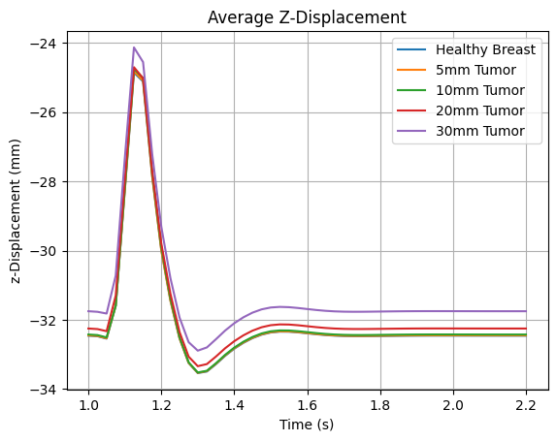
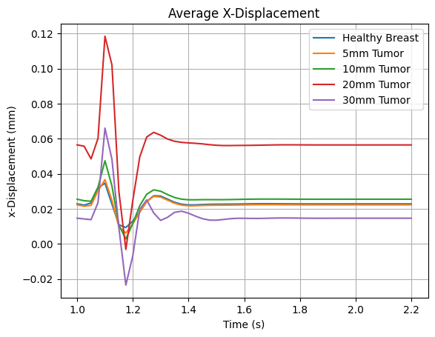
Results: Tumor Size
Spherical Tumors: 5mm, 10mm, 20mm, 30mm

Slide 19
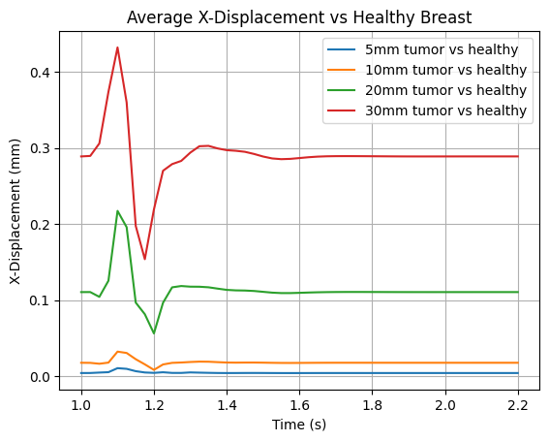
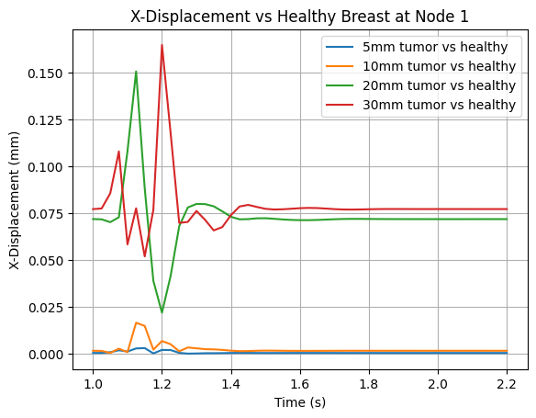
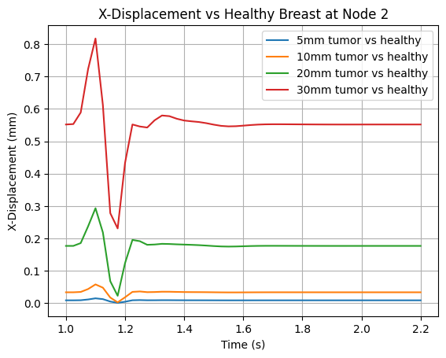
Results: Tumor Size
Increased tumor size → larger deformation
= highly dependent on location

Slide 20

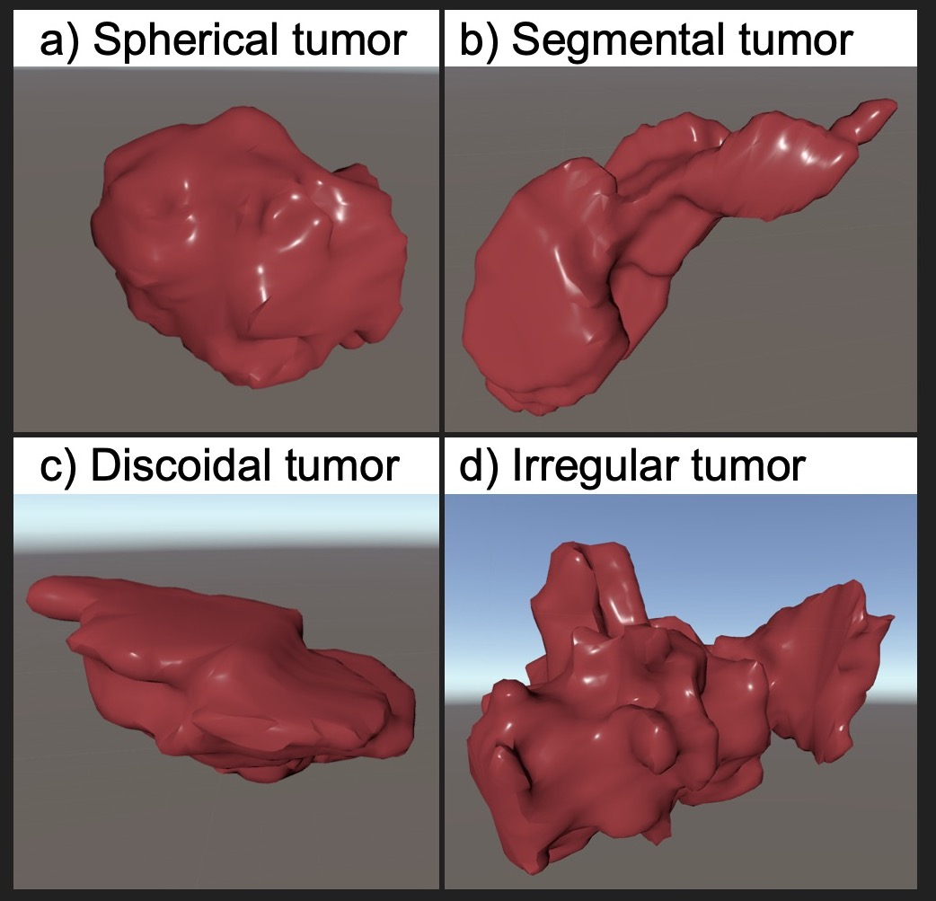
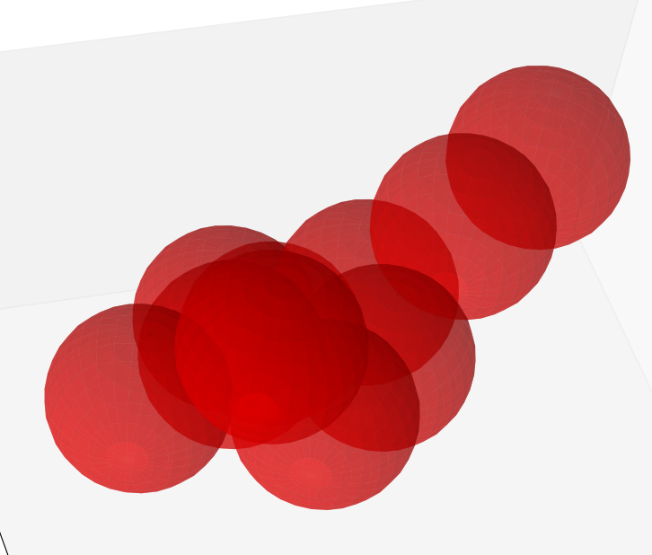
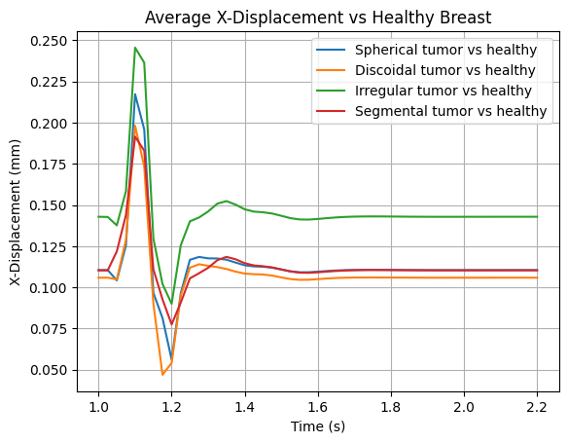
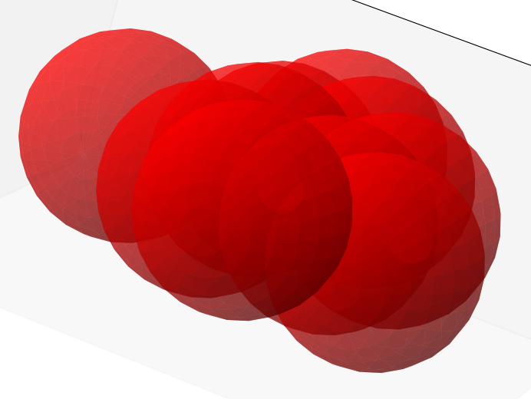
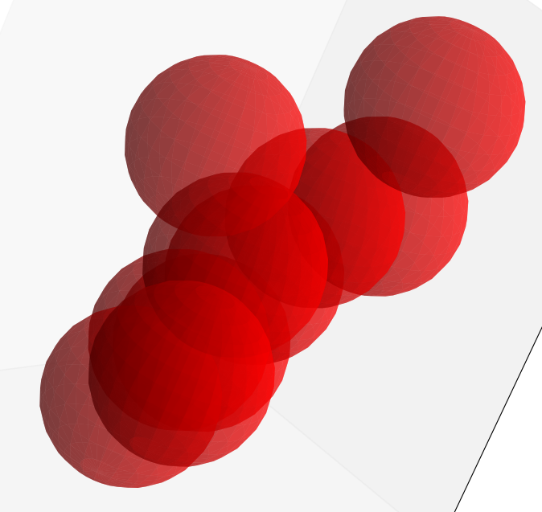
Results: Tumor Morphology
Tumor volume ≈ 4.1 cm³ (within 5%)
*Brook K. Byrd1, *Venkataramanan Krishnaswamy2, *Timothy B. Rooney3, *Rebecca A. Zuurbier3, Richard J. Barth Jr.4
1Thayer School of Engineering, Dartmouth College, Hanover, NH;2CairnSurgical, Inc., Lebanon, NH;3Department of Radiology, Dartmouth-Hitchcock Medical Center, Lebanon, NH;4Department of Surgery, Dartmouth-Hitchcock Medical Center, Lebanon, NH

Slide 21
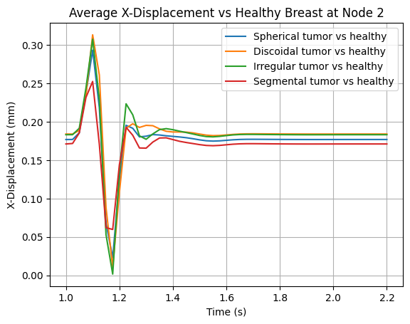
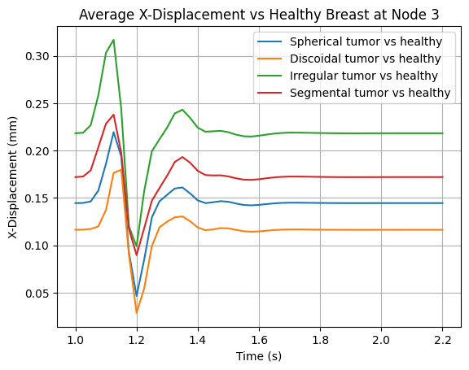
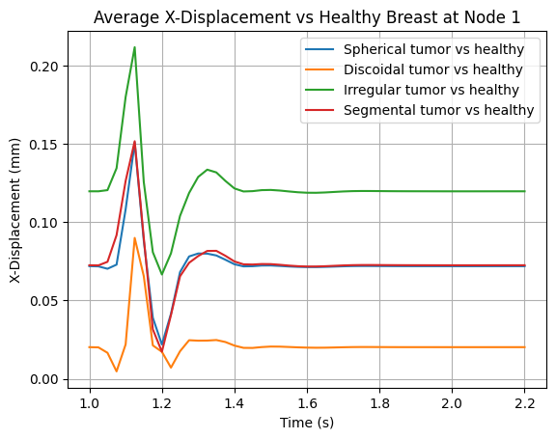
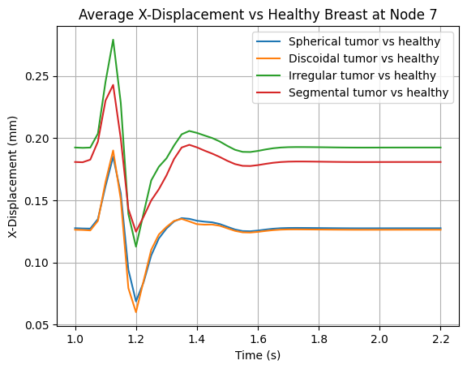
Results: Tumor Morphology
Tumor morphology affects deformation
= highly dependent on location
*Brook K. Byrd1, *Venkataramanan Krishnaswamy2, *Timothy B. Rooney3, *Rebecca A. Zuurbier3, Richard J. Barth Jr.4
1Thayer School of Engineering, Dartmouth College, Hanover, NH;2CairnSurgical, Inc., Lebanon, NH;3Department of Radiology, Dartmouth-Hitchcock Medical Center, Lebanon, NH;4Department of Surgery, Dartmouth-Hitchcock Medical Center, Lebanon, NH

Slide 22

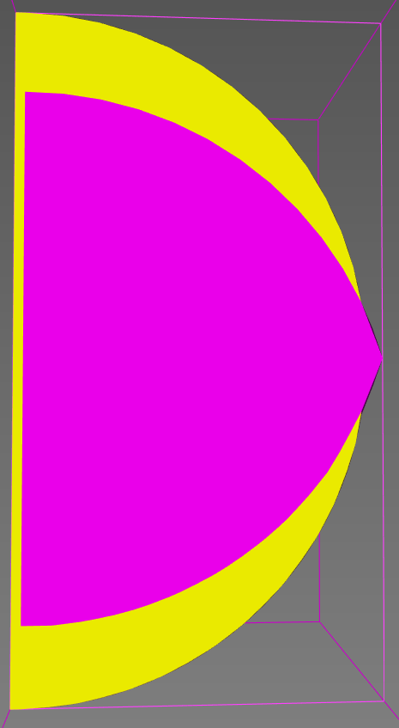
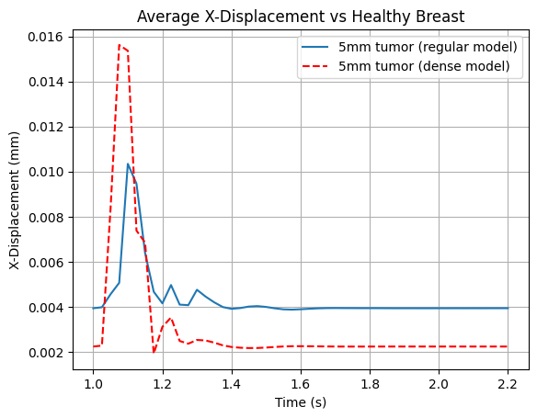
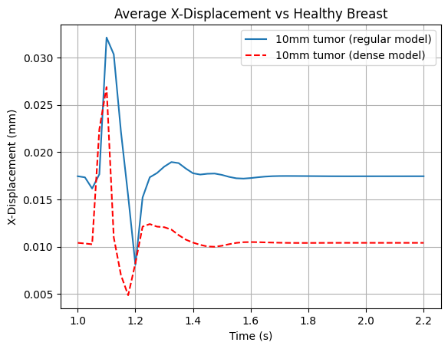
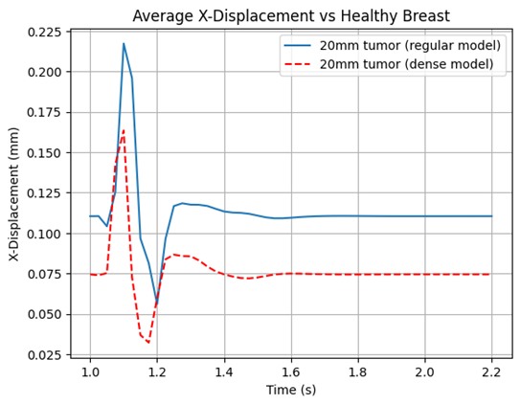
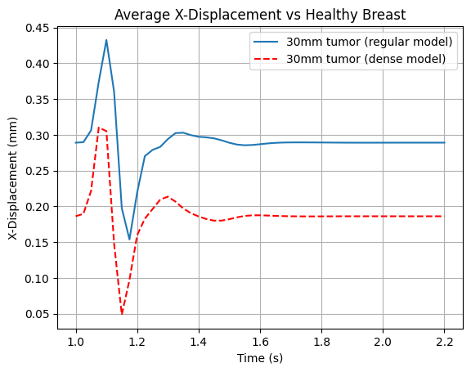
Results: Breast Density
Regular Breast
Dense Breast
Spherical Tumors: 5mm, 10mm, 20mm, 30mm
5mm: greater displacement in dense model
Glandular (30%)
Glandular (80%)
Adipose (70%)
Adipose (20%)

Slide 23
Discussion and Future Improvements
Only small step in much larger process
Work in progress:
Tissue heterogeneity
Real breast data acquisition → improve model
"Small steps taken consistently create the biggest journeys."

Slide 24

Acknowledgement
Early Warning Scan & YvYa Foundation
Tom Sanders
Patrick Peffer
Silvia Schouten
Coen Hurkmans
Ryan Engels
Sioux
Nicholas Kurniawan

Slide 25
Conclusion
Increased tumor size → larger deformation difference vs control
Highly dependent on location
Tumor morphology affects deformation
Highly dependent on location
Small tumors: deformation vs control enhanced in dense breast model

Slide 26
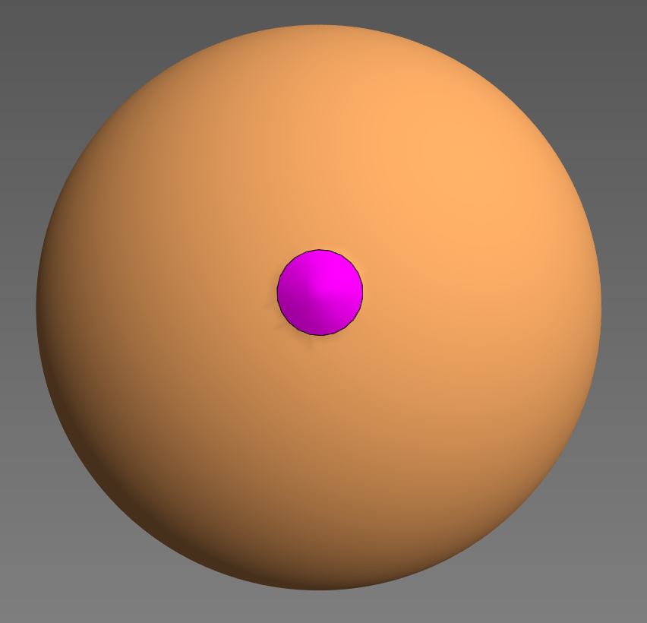
N3
N2
Tumor
N9
N8
N1
N4
N5
N6
N7
z
x

